Slide 1
ET VOILA
An Online Shopping Store

Slide 2
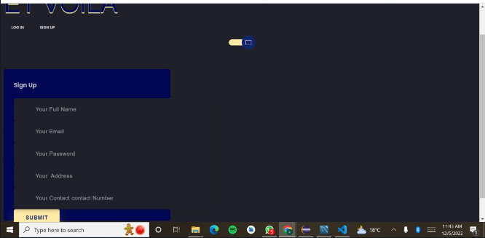
Registration Page
To use this website, the user/admin must register.

Slide 3
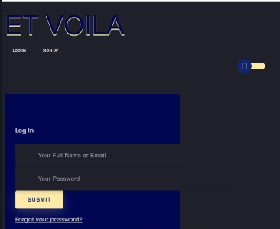
Login Page and Logout
To use this website, the user/admin must have to login to continue.

Slide 4

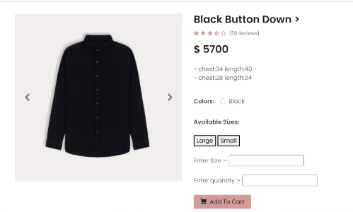
Searching for a specific item
User View

Slide 5
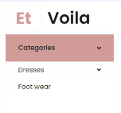
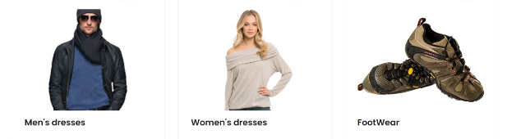
Homepage Buttons
To select a category, the user could either press the button on the navigation panel or scroll down and select the pictorial button

Slide 6
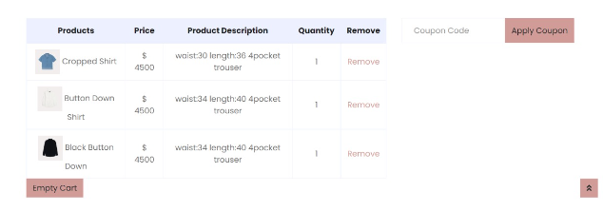
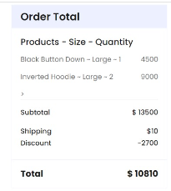
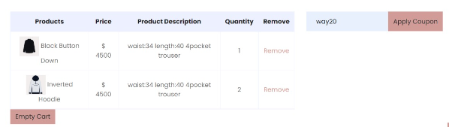
Shopping Cart
Adding/Removing/Emptying
Applying Coupons

Slide 7
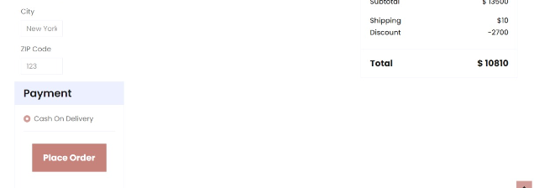
Checkout

Slide 8
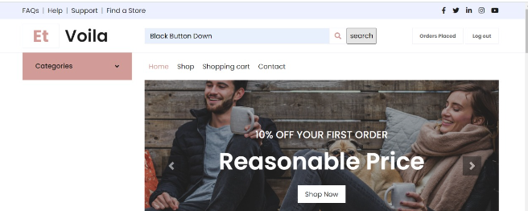

Place Order
After placing order, the customer may press the button ‘order placed’ to check their order details

Slide 9
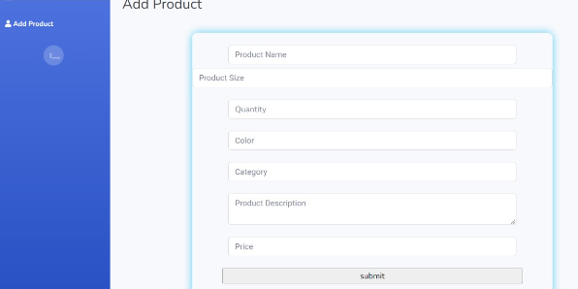
Admin View
Admin View
Add a new product to sell
Add a new product to sell

Slide 10
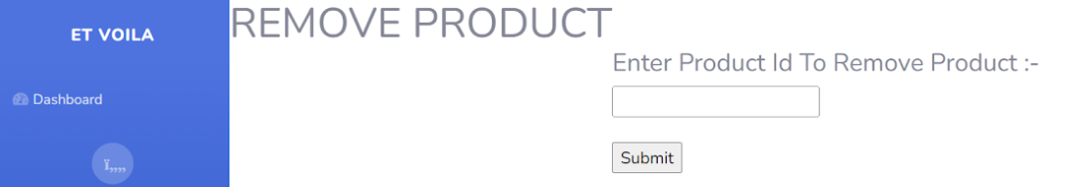
Admin View
Remove a product

